Slide 1


Application of Rules 2025

Slide 2
Application of the Rules
Game scenarios
Umpires, Managers,
Coaches, Parents
& Volunteers

Slide 3
TODAYS TOPICS OF DISCUSION
Batting out of order
What is the base path?
Runners' lane violations
Runners’ leaving early
Illegal Pitches
Obstruction vs Interference
Batter/Catcher/Umpire Interference
When to award bases and how many
What can you do with unruly spectators
10 misinterpreted Little League rules

Slide 4
Batting out of Order
Batting out of order is an appeal play. You should never point out an improper batter on your own initiative, nor should you let the scorekeeper or anyone else "outside the fence" have any say. Only members of the team on defense can ask for time and appeal a batting order issue, although the offense can ask for time and rectify the mistake while the improper batter is still at bat.

Slide 5
Batting out of Order
Situation
In the top of the second inning, with one out and base runners on first and third, the batter hits a ground ball up the middle and into center field. The runner scores from third and the runner from first advances to second base on the apparent RBI single. Before the next batter enters the batter’s box, the Manager of the defensive team calls for “time” and approaches the home plate umpire. The Manager notes on the line-up card that the offensive team skipped a batter in the lineup, and requests that the batter who just singled be called out and the run that just scored be disallowed.
Ruling
Because of when the defensive Manager brought the offensive team’s oversight to the attention of the umpire, dictated how the umpire ruled. In this instance, because the defensive team appealed to the home plate umpire after the out-of-turn at-bat occurred and before a pitch was delivered to the next batter, the umpire ruled that batter who was supposed to bat in that slot is out, and the result of the out-of-turn batter’s at-bat (the run that scored) is disallowed. The base runners are re-set to first base and third base.

Slide 6
Batting out of Order
Explanation
Rule 6.07 (b) batting out of turn – states that when an improper batter becomes a runner or is retired, and the defensive team appeals to the umpire before the first pitch to the next batter of either team, or before any play, or attempted play, the umpire shall (1) declare the proper batter out; (2) nullify any advance or score made because of a ball batted by the improper batter’s advance to first base on a hit, error, base on balls, a hit batter, or otherwise. Note: If any base runner advances on their own during an improper at-bat (such as an on wild pitch or passed ball), that advance shall be deemed legal.
There are several situations where batting out of order may occur, resulting in different rulings. Reference rule 6.07 – Batting out of Turn – to get a full understanding of this rule’s application.

Slide 7
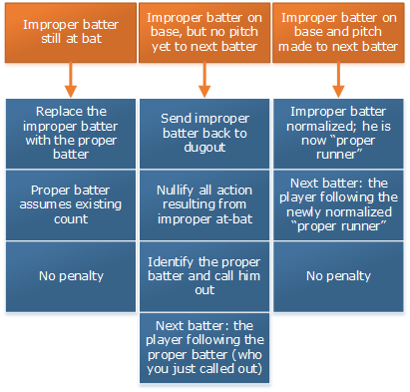
Batting out of Order

Slide 8
What is the base path
There is no such thing as a base path (none exists) until a play is made on a runner. The base path is established when a fielder with the ball attempts to tag a runner. Then, and only then, is there a base path. And the base path is a straight line from the runner's position to the base to which he is advancing or retreating.
"A runner's base path is established when the tag attempt occurs and is a straight line from the runner to the base he is attempting to reach safely."
In other words, the base path is established (created) "when the tag attempt occurs.“
The rule allows a runner up to three feet either way off his base path to avoid a tag.

Slide 9
Runners’ lane violations
RULE 6.05 – A batter is out when –
(j)
In running the last half of the distance from home base to first base, while the ball is being fielded to first base, he runs outside (to the right of) the three-foot line, or inside (to the left of) the foul line, and in the umpire's judgment in so doing interferes with the fielder taking the throw at first base.
All of the following conditions must be met:
Throw is coming from behind Batter/Runner
The defense MUST THROW the ball
Must be a reasonably catchable throw
According to the Approved Ruling: the lines marking the three-foot lane are a part of that lane and a batter-runner is required to have both feet within that three-foot lane or on the lines marking the lane.

Slide 10
Runners’ leaving early (Majors and below)
Situation
With one out, and runners on first and second base, the batter has a count of two strikes, one-ball. As the pitcher delivers the next pitch, the runner on second base leaves the base before the pitch reaches the batter. The base umpire, located in the “C position” – behind and to the left of the shortstop – drops the red signal flag as the batter hits a ground ball to the shortstop. The shortstop fields the ball and throws to second base to retire the runner originally on first base. At the end of the play, there are runners on first and third base, with two outs. After the play ends, the base umpire calls “time” and proceeds to return the runner on third base back to second base, citing that the runner left early. With the runner returned to second base, and the ball having not yet been put back into play, the offensive manager approaches the base umpire, and states that the runner in question should be left at third base because the shortstop chose to make a play on the runner attempting to reach second base. Should the base umpire change his call because returning the runner to second penalizes a runner who was forced to advance?

Slide 11
Runners’ leaving early
Explanation
In the judgment of the umpire, the runner left the base before the pitch reached the batter located in the batter’s box, regardless of whether he was forced to advance, or not. It is not necessary for the pitch to reach the catcher for a runner to attempt to steal, but it must have reached the batter before a runner may legally release and attempt to advance. Secondly, the decision as to where the defense chooses to attempt a putout does not impact the decision, because the violation occurred prior to next play.
SOFTBALL
7.08 – Any runner is out when –
(4) (b) Minors and below (Local League option for Majors):
the runner fails to keep in contact with the base which that runner is entitled until the ball has been batted or reaches the batter.

Slide 12
Illegal Pitches
RULE 8.05
(e) – Baseball (c) – Softball: the pitcher makes a quick pitch; Umpires will judge a quick pitch as one delivered before the batter is reasonably set in the batter’s box.
The penalty for Rule 8.05(e) (c), regardless of whether there are runners present or not, is a ball. This is an instance in which an illegal pitch, by Little League (Major)/ Minor League definition, can occur without runners on base. Intermediate (50-70) Division/ Junior/ Senior: With runners on base, Rule 8.05(e) is penalized with a balk; with no runners on base, Rule 8.05(e) is penalized with a ball.

Slide 13
Illegal Pitches
RULE 8.05
Baseball only - (g) the pitcher makes any motion naturally associated with the pitch while not touching the pitcher’s plate;
NOTE: Rule 8.05(g) is an illegal pitch (Rule 2.00). Little League (Major)/ Minor League: The penalty for Rule 8.05(g), regardless of whether there are runners present or not, is a ball. This is an instance in which an illegal pitch, by Little League (Major)/ Minor League definition, can occur without runners on base. Intermediate (50-70) Division/ Junior/ Senior League: With runners on base, Rule 8.05(g) is penalized with a balk; with no runners on base, Rule 8.05(g) is penalized with a ball.

Slide 14
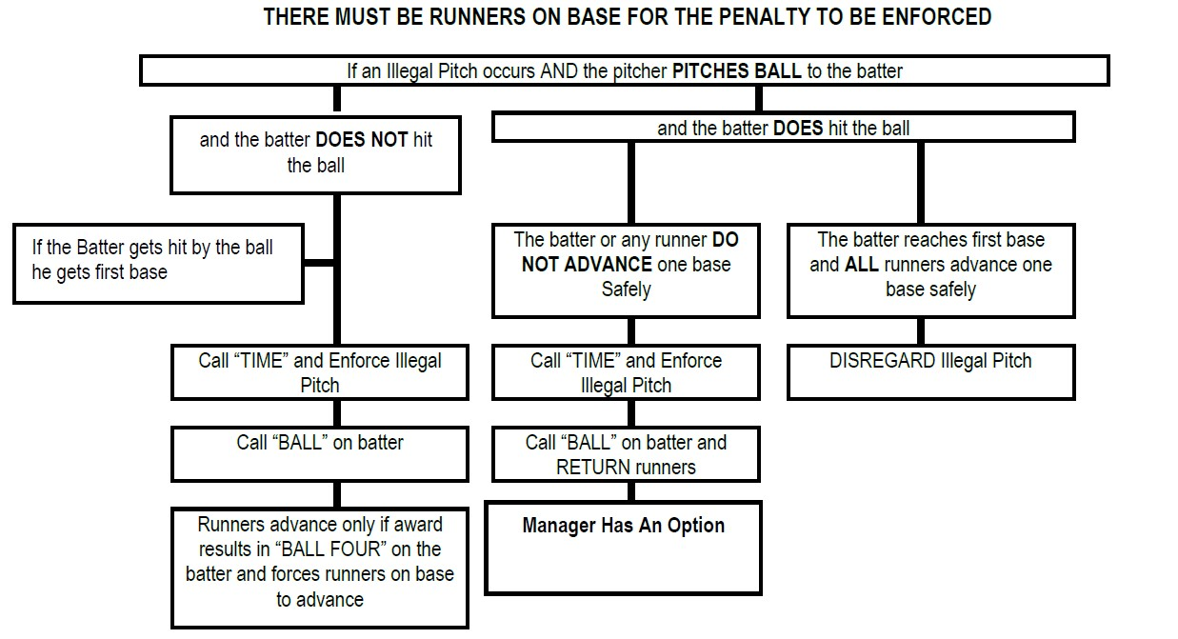
Illegal Pitches

Slide 15
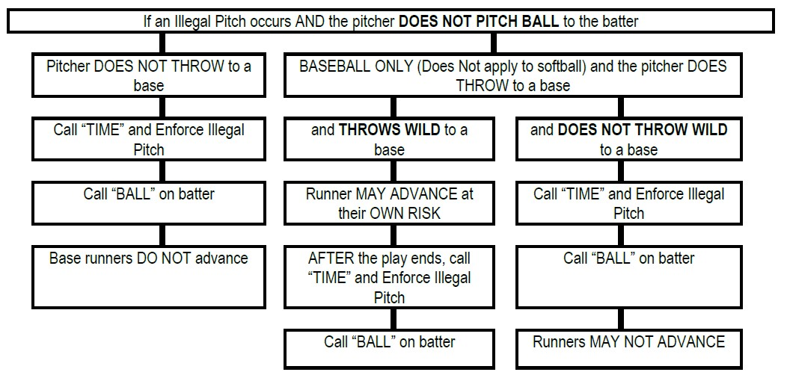
Illegal Pitches

Slide 16
Defining Obstruction vs. Interference
The terms interference and obstruction are often misunderstood and confused by managers, coaches, and umpires alike.
Interference usually refers to an act by the offensive team that impacts the defense making a play. Obstruction refers to a fielder who hinders a runner.
In the simplest of terms, interference is a ‘penalty’ against the offense, and obstruction is a penalty against the defense.
There are 2 types of obstruction: type “A” is when a play is being made on a runner, and type “B” is when no play is being made on the impeded runner.

Slide 17
Defining Obstruction vs. Interference
Understanding Base Runner Interference — Rule 7.09
(j) The runner fails to avoid a fielder who is attempting to field a batted ball, or intentionally interferes with a thrown ball, provided that if two or more fielders attempt to field a batted ball, and the runner comes in contact with one or more of them, the umpire shall determine which fielder is entitled to the benefit of this rule, and shall not declare the runner out for coming in contact with a fielder other than the one the umpire determines to be entitled to field such a ball.
Immediate dead ball, runner is out.

Slide 18
Defining Obstruction vs. Interference
Obstruction
Situation A:
After a clean hit to the outfield, the batter-runner attempts to stretch it into a double. As the runner approaches second base, the shortstop fakes a tag without possession of the ball.
Ruling: A fake tag is considered obstruction, and the umpire is to award whatever bases will nullify the obstruction.

Slide 19
Defining Obstruction vs. Interference
Obstruction
Situation B:
The batter hits a ball to the outfield, and while rounding first base the batter-runner contacts the first baseman. The defense relays the ball to second base, where the runner is tagged out.
Ruling: The runner was obstructed by the first baseman, which altered progress toward second base. After the play ends, the umpire is to call “time,” announce obstruction has occurred, and awards bases as necessary, which nullifies the obstruction.

Slide 20
Defining Obstruction vs. Interference
Interference
Situation A:
With a runner on first base, the batter hits a ground ball toward the second baseman. The batted ball strikes the runner from first base before it reaches the second baseman.
Ruling: This is interference, the ball is immediately declared “dead,” the runner is declared out and the batter is awarded first base. If there had been other runners on base, they would return to the base they occupied at the time of the pitch, unless they are forced to advance by the batter being awarded first base.

Slide 21
Defining Obstruction vs. Interference
Interference
Situation B:
With a runner on second base, the batter hits a soft line drive toward the shortstop. The runner breaks for third base when the batter contacts the ball, and the batted ball touches the runner and caroms away. The shortstop catches the ball before it contacts the ground and throws to second base to double off the runner.
Ruling: This is interference. The ball became “dead” the moment it touched the runner. The runner is declared out and batter-runner is awarded first base.

Slide 22
Batter/Catcher/Umpire Interference
UMPIRE Interference
Situation A:
During a Senior Division baseball game, with a runner on second base, the batter hits a sharp ground ball, which strikes the umpire before it reaches an infielder.
Ruling: This is interference by the umpire. The ball is dead, and the batter-runner is awarded first base. The other runners are returned to the base they occupied at the time of the pitch, unless they are forced to advance by the award of first base to the batter-runner.

Slide 23
Batter/Catcher/Umpire Interference
UMPIRE Interference
Situation B:
During a Junior Division baseball game, a runner on first base attempts to steal second base. As the catcher attempts to throw to second base contact is made with the home plate umpire, which effects the throw.
Ruling: This is interference by the umpire. If the throw retires the runner, the out will stand. If the runner is not retired, the runner is returned to the base occupied at the time of the pitch.

Slide 24
Batter/Catcher/Umpire Interference
Catchers Interference
Rule 6.08 (c)
This rule usually applies to the catcher reaching for a pitched ball and his glove is hit with the bat as the batter swings. If the ball is not put in play, the ball is dead and the runner is awarded first base and all runners forced to advance may advance. If the ball is hit in play, the result is termed a “delayed dead ball,” meaning that the umpire should allow the play to continue until a point where no further action is possible and then call “time” and enforce such penalties or awards as required.
If the ball is put in play and all runners, including the batter, advance at least one base, then play continues without further reference to the catcher’s interference. Any advances or outs stand.

Slide 25
Batter/Catcher/Umpire Interference
Catchers Interference
Example 1:
With a runner on second base, and no outs, the batter hits ball to right field. The base runner advances to third base and tries to score, but is thrown out at home plate. The batter-runner rounds first base and advances to second base on the throw. This play stands and the offensive manager has no choice to enforce the catcher’s interference.
If the ball is put in play and the play is allowed to continue and any runner, or the batter, fails to advance at least one base, the manager of the offense may choose to elect to take the result of the play or enforce the batter’s interference rule.

Slide 26
Batter/Catcher/Umpire Interference
Catchers Interference
Example 2:
The following is an example of when a manager may choose to accept the play over the interference penalty.
With a runner on third base only, no outs, and the catcher interferes with the batter’s swing at the pitch but hits a long fly ball to center field where it is caught by the center fielder. The runner at third tags and scores. Because the batter did not reach first base, the offensive manager has two choices:
(1) Enforce the catcher’s interference rule, which would place the batter runner on first base, and return the runner who was on third base back to that base with no outs; or
(2) Accept the result of the play, putting the batter out, and allowing the runner on third base to score.

Slide 27
Batter/Catcher/Umpire Interference
Catchers Interference
In Junior and Senior Baseball divisions (Rule 7.07),
If a runner on third is attempting to steal home on a squeeze play and the catcher interferes with the batter either by hitting his bat or moving in front of the plate denying the batter the opportunity to hit the ball, “time” should be called, the batter awarded first and the runner from third awarded home as well. However, if the runner on third is not attempting to steal home, then the batter should be awarded first, and the runner remain at third unless forced.
The reason for scoring the run on a squeeze play is to discourage the defense from intentionally interfering with the batter in order to prevent the runner from scoring.

Slide 28
Batter/Catcher/Umpire Interference
Batter Interference
When Batter Interference occurs with runners stealing, let the catchers actions help with your decision. The ball does not have to be thrown; however, the catcher must prove that he/she was trying to throw the ball to a base to make a play. If the catcher throws the runner out, disregard the interference. Should the runner advance safely, enforce the interference, call the batter out for the interference and return the runner.
The plate umpire should call the pitch, stand up and verbalize, “That’s Interference”, watch the actions of the catcher and the play. If the runner is put out, the umpire should verbalize, “Disregard the interference”.

Slide 29
When to award bases and how many
FOUR BASE AWARD
Intentionally touching a fair batted ball with equipment or clothing detached from it’s normal place, or thrown glove.
THREE BASE AWARD
Home Run

Slide 30
When to award bases and how many
TWO BASE AWARD
Fair batted ball bounds out of play (ground rule double)
Ball overthrown out of play (first play by infielder on runner – time of pitch. All other cases – time of throw)
Fly ball deflected out of play by the fielder
Bounding ball deflected out of play by a fielder
Thrown ball illegally touched (cap, mask, other part of the uniform, or thrown glove)

Slide 31
When to AWARD bases and how many
ONE BASE AWARD
A fielder, after catching a fly ball, falls into dead-ball territory
A pitch goes out of play, or an overthrow by pitcher (while on rubber) goes out of play
Catcher’s interference – Batter and any runners forced to advance
Runner from third is touched by a pitched ball while attempting to steal home
A pitched ball lodges in the catcher’s or umpire’s clothing or gear
Fair batted ball strikes a base runner (batter only – base runner is out) or umpire before passing infielder
Hit by pitch
Base on balls

Slide 32
What to do with unruly spectator
Ask for the score keeper to find the field representative.
This could be the President, Vice President or another Board Member, the designated field representative for the game/night.
Get the manager(s) involved in policing the “fans”
If it persists, send all of the players to their respective dugouts.
Bring the managers of both teams out and explain to both of them what it will take to get the game going again.
If all else fails, declare the game a forfeit and leave the field and area immediately (preferably in the direction away from the most aggressive spectator)

Slide 33
Rule misconceptions
1. The hands are considered part of the bat. If a pitch hits the batter’s hands it is either fair or foul.
Approved Ruling: The hands are part of the batter’s body. Therefore, an umpire must judge if the ball hit the bat or the batter first. This scenario is covered by Little League rule 2.00 and 6.08(b). Ball, Strike, Batter on 1B?
2. If the batter “breaks his wrists” when swinging, it’s a strike.
Approved Ruling: The term “breaks his/her wrists” does not appear in the Little League rulebook. The umpire must judge whether, or not, the batter attempted to swing at the pitch as stated in the definition of a strike in Rule 2.00.
3. If a batted ball hits the plate first it’s a foul ball.
Approved Ruling: Home plate, first, second, and third base are all completely within fair territory. The foul lines are also within fair territory. In order to rule the ball foul, it must have come to rest in foul territory or be touched in foul territory. See Rule 2.00.

Slide 34
Rule misconceptions
4. The batter cannot be called out for interference if he is in the batter’s box.
Approved Ruling: Offensive/Batter Interference is defined in Rule 2.00, and there is no specific exception for the batter’s box. The batter’s actions are what causes interference and not necessarily where he is, as defined in Rule 6.06(c) (1), (2) and (3).
5. The ball is dead on a foul-tip.
Approved Ruling: As defined in Rule 2.00, the ball is always live on a foul tip. Therefore, runners may be put out or advance at their own risk.
6. The batter may not switch batter’s boxes after two strikes.
Approved Ruling: The batter may switch batter’s boxes at any time while the ball is dead. According to Rule 6.06(b), the batter may only be called out for stepping from one batter’s box to the other while the pitcher is in position ready to pitch. The number of balls or strikes on the batter is not relevant.
7. The batter who batted out of order is the person declared out.
Approved Ruling: According to Rule 6.07, the batter that is supposed to bat (the proper batter) is the one that is declared out, when the defensive properly appeals the infraction.

Slide 35
Rule misconceptions
8. The batter is considered “out” if he/she starts for the dugout before going to first base after an uncaught third strike.
Approved Ruling: In order to declare the batter “out” for abandoning his/her effort to advance, he/she must step into “dead ball” territory.
9. The batter-runner is always out if he runs outside the running lane after a bunted ball.
Approved Ruling: The batter-runner may be called out for interference if he fails to run within the runner’s lane for the last half of the distance to first base. The batter-runner is not out merely for not running to first base in the runner’s lane. The batter-runner would be out if they run outside of the runner’s and lane and, in the judgment of the umpire, interfere with the fielder at first base fielding the throw. Furthermore, the defensive team must throw the ball in order for the interference to occur Rule 6.05(j).
10. If a batter swings at a pitch, and the pitch hits the batter in the batter’s box, the batter is awarded first base.
Approved Ruling: The batter is not awarded first base. A strike is defined in Rule 2.00(e). Since the batter swung, a strike is recorded, and, if it was the third strike, the batter is out. No uncaught strike situation occurred since the ball is dead once it contacts the batter.

Slide 36
Game Management
Start of the game plate meeting
Introduce yourself and any partner you have out there with you.
Explain to the managers not to come out of the dugout unless time is granted, and if they have a question for a specific umpire, they can go to that umpire.
Take home team’s line up
Verify eligible pitchers and jersey numbers match duplicates.
Take away team’s line up
Verify eligible pitchers and jersey numbers match duplicates.
Cover ground rules and field specifics
No reason to cover anything already covered by the book
Don’t ask if they have questions
Shake hands, promote sportsmanship and hustle and have a blast!

Slide 37
Game Management
Introduce yourself to the catcher
They will be protecting you during the game
Every half inning
1 Minute or 8 pitches between innings (max)
Pitching Changes
Record the pitching changes on your line up and any other changes that need to be recorded
Track how many times the manager/coach talk to the pitcher

Slide 38
Thank You

